Slide 1
Dated Data: Tracing Knowledge Cutoffs in Large Language Models
Jeffrey Cheng, Marc Marone, Orion Weller, Dawn Lawrie, Daniel Khashabi, Benjamin Van Durme
Notes:
Introduce self, paper

Slide 2
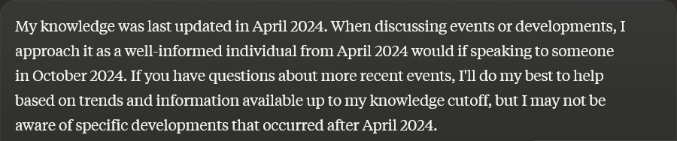
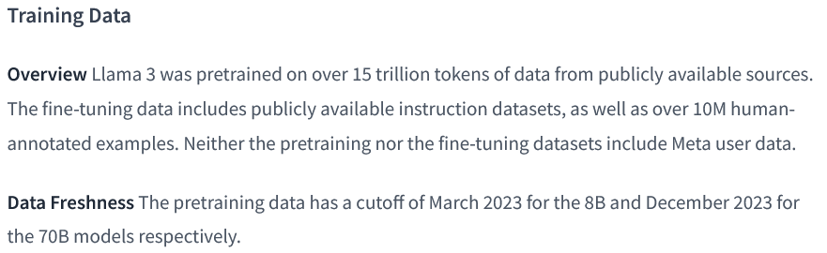
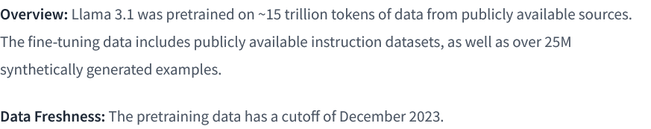

Knowledge Cutoffs
Notes:
What are knowledge cutoffs? -> Due to competitive reasons, LLM providers …, and instead report a single knowledge cutoff date.

Slide 3
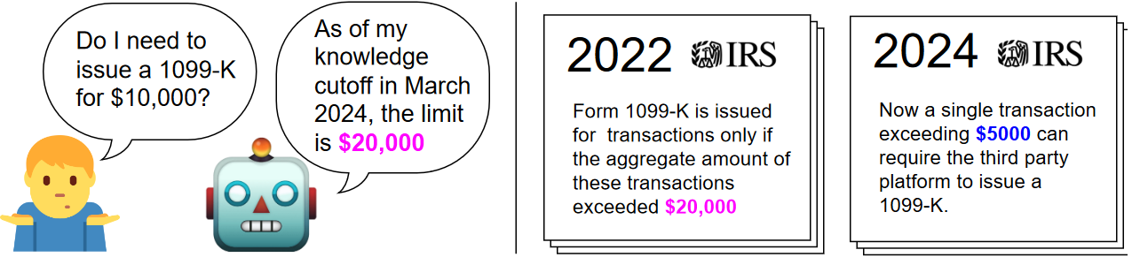
Key Considerations
Do all resources in the training data share the same reported knowledge cutoff?
Is the model’s knowledge of these resources aligned to their reported cutoff date?
The effective cutoff of an LLM with respect to a resource is the date that best matches the LLM’s knowledge of that resource.
Notes:
This single reported cutoff brings about several questions, … relevant to LLM users who require up-to-date information
One can imagine an LLM user
To answer these questions, we define the effective cutoff

Slide 4
Are there discrepancies between effective and reported cutoffs?
Notes:
First central question: are there discrepancies
We hypothesize that discrepancies can occur because … . However other versions of the resource could exist in the model’s training data
To consider a concrete example, if a Wikipedia dump, say October 2024, is present in a model’s training data one might expect
To determine effective cutoffs, we first create long time-spanning datasets and measure the perplexity across the data and determine the effective cutoff from these perplexity measurements. Crucially, our method does not require … later verify our results with ground truth data.

Slide 5
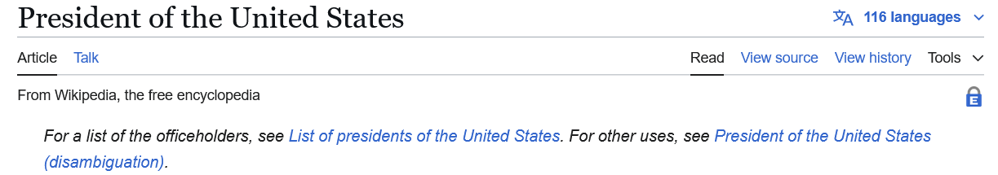
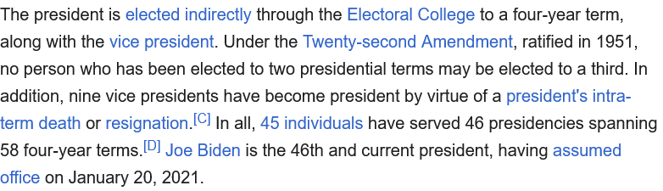
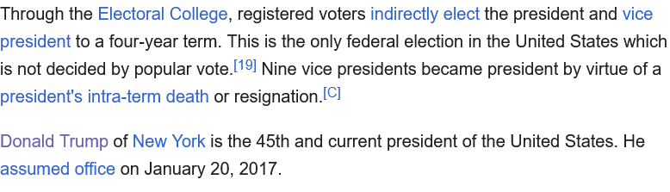
Key Considerations
Notes:
We hypothesize that discrepancies can occur because … . However other versions of the resource could exist in the model’s training data
To consider a concrete example, if a Wikipedia dump, say October 2024, is present in a model’s training data one might expect
To determine effective cutoffs, we first create long time-spanning datasets and measure the perplexity across the data and determine the effective cutoff from these perplexity measurements. Crucially, our method does not require … later verify our results with ground truth data.

Slide 6



Time Spanning Datasets
Updating Resource
Building Resource
Static Resource
WIKISPAN:
Collect 5000 most edited topics
Scrape monthly versions from April 2016 to April 2023
Notes:
We first broadly split the resources seen by LLMs into three categories
3 types of resources
- updating
- building
- static

Slide 7
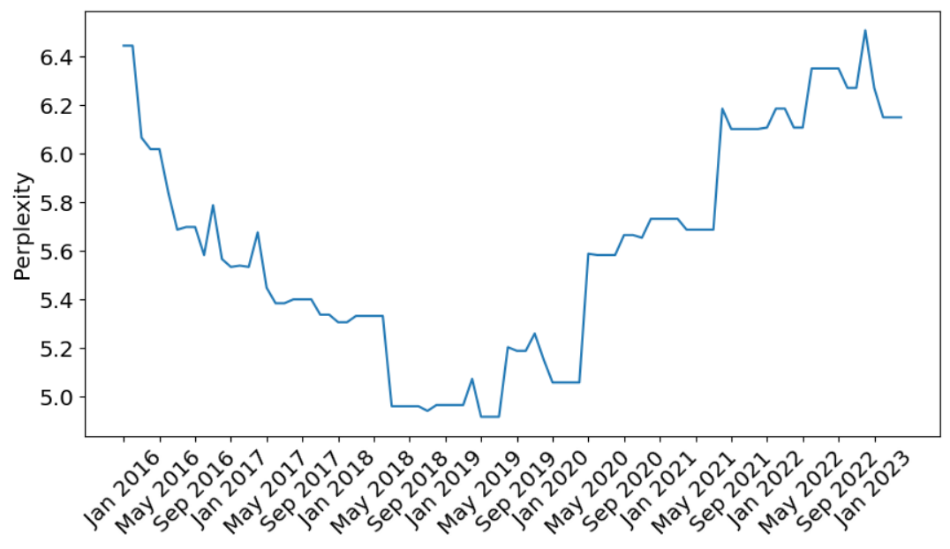
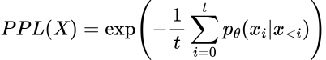
Probing Methodology
WIKISPAN documents: version of Wikipedia topic t at time m
Measure perplexity of first 512 tokens of each document, across all topics and months
Perplexity of the Wikipedia document “Liverpool'' under Pythia-7b. Each point is the perplexity of the document at that time.
Notes:
A document in WikiSpan is simply a

Slide 8
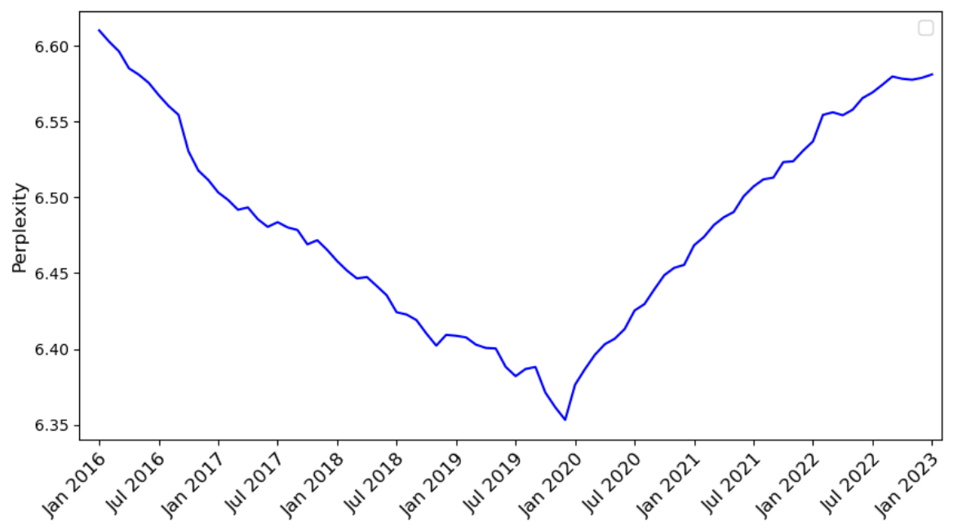
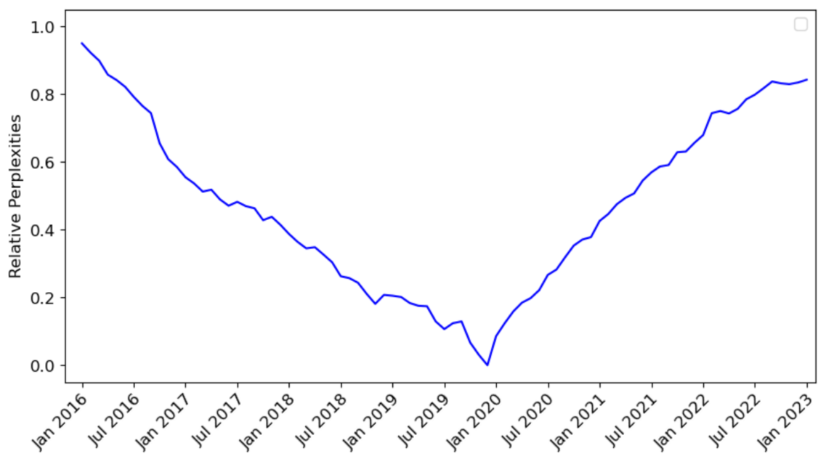
Probing Methodology
Normalization
Aggregate perplexities with 95% truncated mean within each month
Perform 0-1 normalization over entire time-span
Effective knowledge cutoffs are the argmin of relative perplexity curves
Perplexity measurements of documents
Aggregate along month axis with truncated mean
Convert to relative perplexities by 0-1 scaling
Notes:
Given the set of perplexity curves for each topic, we can aggregate them to get a

Slide 9
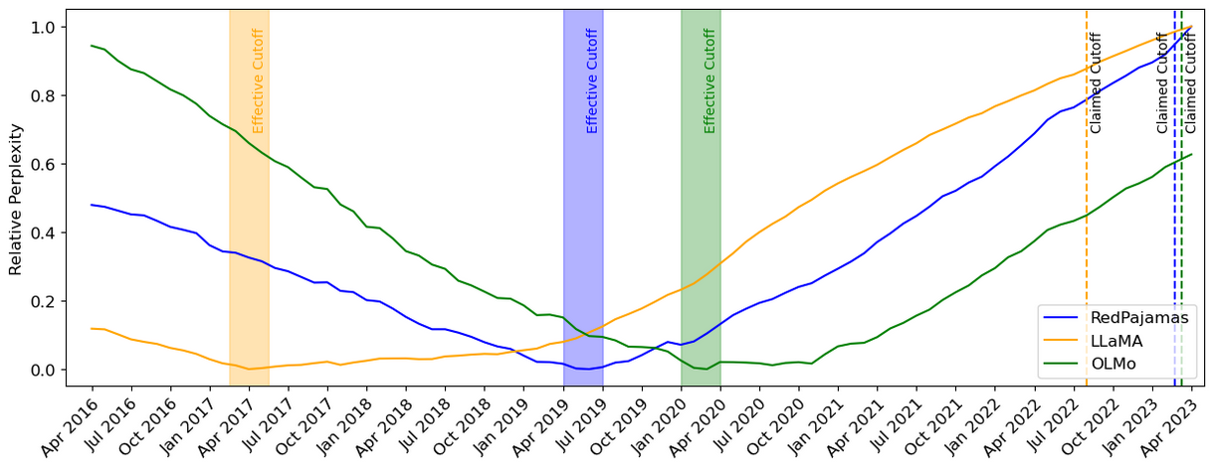
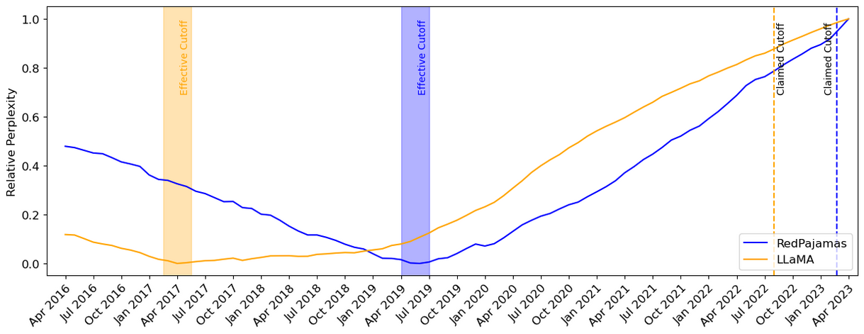
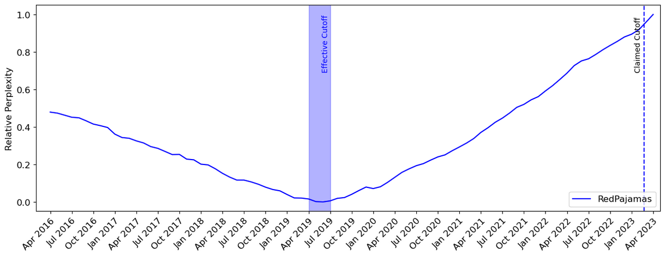
Wikipedia Results – C4 Derived Models
LLaMA (Meta)
We add Wikipedia dumps from the June-August 2022 period, covering 20 languages, which use either the Latin or Cyrillic scripts: bg, ca, cs, da, de, en, es, fr, hr, hu, it, nl, pl, pt, ro, ru, sl, sr, sv, uk. We process the data to remove hyperlinks, comments and other formatting boilerplate.
OLMo (AI2)
Dumps were downloaded from Wikimedia’s website. We use the dump from March 20th, 2023.
RedPajamas (Together Computer)
We use the Wikipedia dataset available on Huggingface, which is based on the Wikipedia dump from 2023-03-20 and contains text in 20 different languages. The dataset comes in preprocessed format, so that hyperlinks, comments and other formatting boilerplate has been removed.

Slide 10
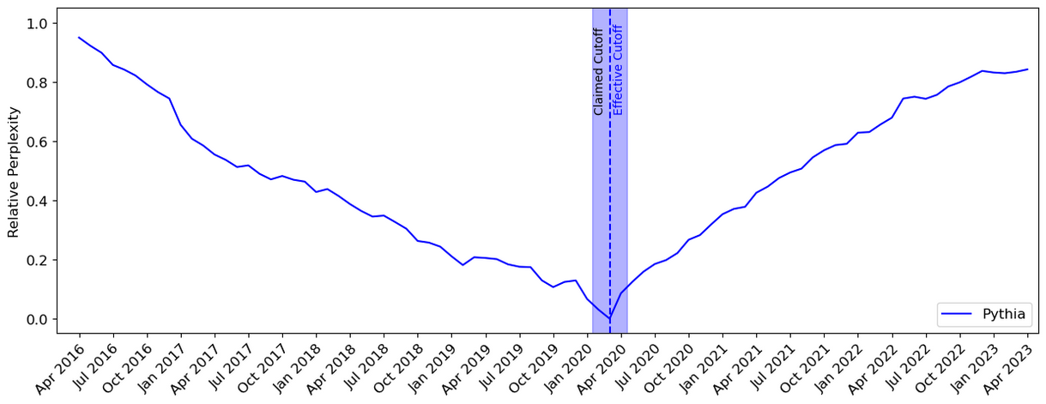
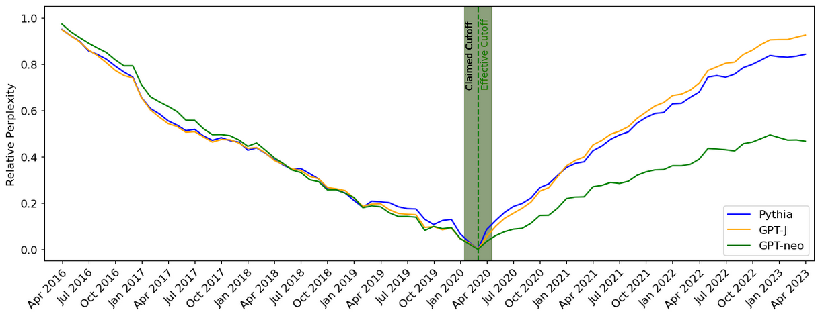
Wikipedia Results – Pile Derived Models
Pile (EleutherAI)
We use the wikipedia/2020301.en dataset from TensorFlow Datasets. We prepend the title to the body of each article, separated by two newlines.

Slide 11
Why do there exist discrepancies between effective and reported cutoffs?
Notes:
These results bring us to the second central question of our paper: why do there exist these discrepancies between effective and reported cutoffs, and why do they exist for only some models?
To answer this question, we conduct a thorough investigation of the open pretraining datasets, in the process indexing over 4T tokens. We find two main reasons for these discrepancies in our analysis

Slide 12
Effective and Reported Cutoff Misalignment
CommonCrawl Misalignments
Complications in Deduplication Pipelines

Slide 13
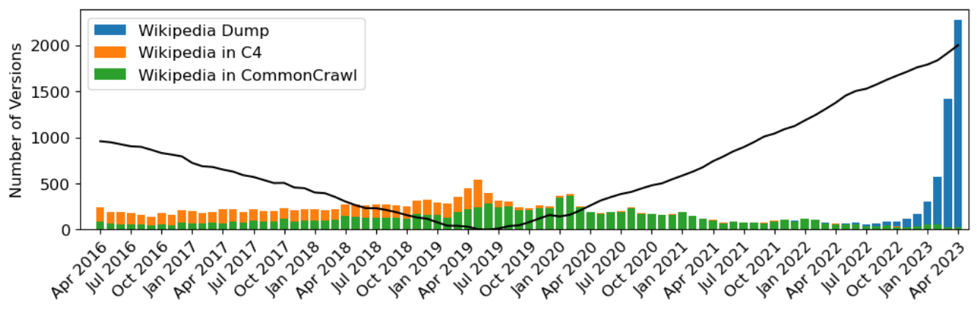
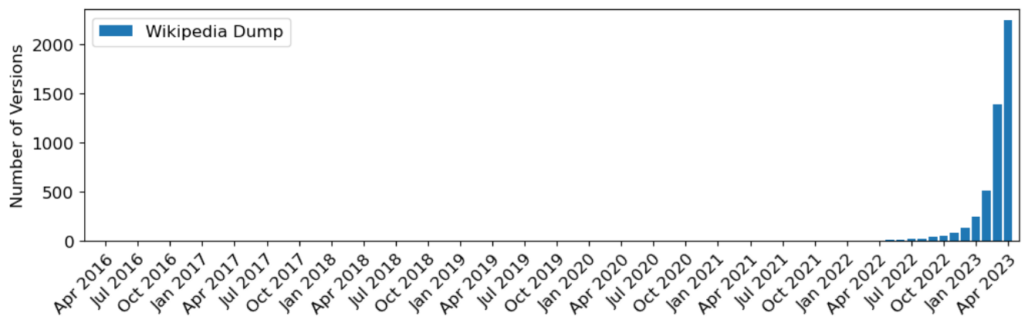
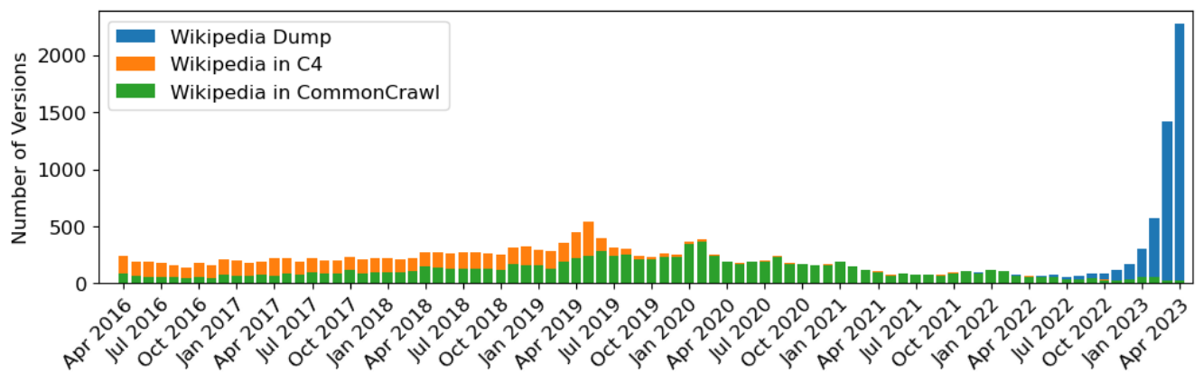
CommonCrawl Misalignments
Many LLMs train on CommonCrawl dumps
Breakdown of RedPajamas training corpus:
CommonCrawl dumps contain old data that bias effective cutoffs.
Notes:
Most modern LLMs train on CommonCrawl dumps
Even when multiple recent dumps are used, aggregated data is still biased toward earlier dates
To see this concretely, we index over the entire pretraining dataset of RedPajamas, looking for versions of the Wikipedia topics evaluated in WikiSPAN. The orange … but over 80% of the

Slide 14
Effective and Reported Cutoff Misalignment
CommonCrawl Misalignments
Complications in Deduplication Pipelines

Slide 15
Deduplication Issues
It is common practice to deduplicate pre-training datasets
Fuzzy deduplication should remove different versions of Wikipedia documents
Exact deduplication should remove exact copies of Wikipedia document
We empirically find many duplicates in pretraining datasets!
By the end of the 17th century, the Chinese economy had recovered from the devastation caused by the wars in which the Ming dynasty were overthrown, and the resulting breakdown of order.[147] In the following century, markets continued to expand as in the late Ming period, but with more trade between regions, a greater dependence on overseas markets and a greatly increased population.[148][149] The government broadened land ownership by returning land that had been sold to large landowners in the late Ming period by families unable to pay the land tax.[150] To give people more incentives to participate in the market, they reduced the tax burden in comparison with the late Ming, and replaced the corvée system with a head tax used to hire laborers.[151] The administration of the Grand Canal was made more efficient, and transport opened to private merchants.[152] A system of monitoring grain prices eliminated severe shortages, and enabled the price of rice to rise slowly and smoothly through the 18th century.[153] Wary of the power of wealthy merchants, Qing rulers limited their trading licenses and usually refused them permission to open new mines, except in poor areas ...
By the end of the 17th century, the Chinese economy had recovered from the devastation caused by the wars in which the Ming dynasty were overthrown, and the resulting breakdown of order.[148] In the following century, markets continued to expand as in the late Ming period, but with more trade between regions, a greater dependence on overseas markets and a greatly increased population.[149][150] The government broadened land ownership by returning land that had been sold to large landowners in the late Ming period by families unable to pay the land tax.[151] To give people more incentives to participate in the market, they reduced the tax burden in comparison with the late Ming, and replaced the corvée system with a head tax used to hire laborers.[152] The administration of the Grand Canal was made more efficient, and transport opened to private merchants.[153] A system of monitoring grain prices eliminated severe shortages, and enabled the price of rice to rise slowly and smoothly through the 18th century.[154] Wary of the power of wealthy merchants, Qing rulers limited their trading licenses and usually refused them permission to open new mines, except in poor areas ...
Notes:
The fact that data in commoncrawl dumps are biased towards earlier dates wouldn’t be as big of an issue if deduplication pipelines were able to detect and filter out these semantically similar documents.
Fuzzy deduplication (minhash)
Exact deduplication (bloom filter)

Slide 16
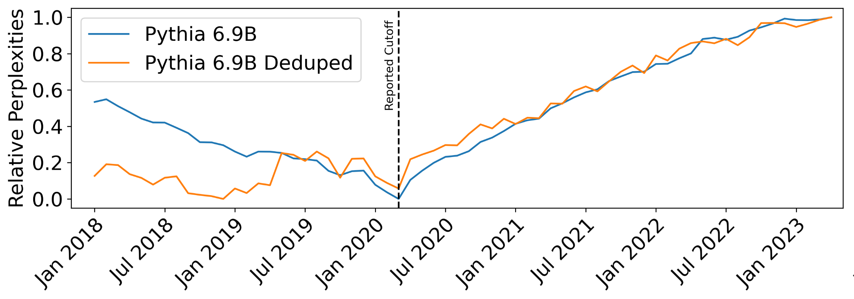
Deduplication Issues
The Pile purposely upsamples Wikipedia documents at reported cutoff
Duplicate documents bias effective cutoff towards their version date.
Notes:
To see the effect of duplicate documents, we first recall that the effective cutoff of Pile derived models matched up with their reported cutoff. One of the reasons behind this agreement is that the pile purposely upsamples the Wikipedia versions at the reported cutoff date.
Duplicate documents will further bias the effective cutoff toward their corresponding date

Slide 17
Conclusions
There do exist discrepancies between effective and reported knowledge cutoffs in modern LLMs
Effective cutoffs of modern LLMs are years earlier than reported cutoff
CommonCrawl dumps include older versions of resources
Old versions and their duplicates are not removed by deduplication pipelines
Effective cutoffs of Pile-derived models matches their reported cutoff
Small amount of CommonCrawl used (< 25% of one CC dump)
3x upsampling of versions at reported cutoff date
Notes:
This is in partially because the relative size of CommonCrawl data in the Pile is much less compared to modern LLM training corpuses. The Pile included tiny fractions of several dumps while many LLMs now use from 5 – 20 full dumps.
The two factors compound on one another. The use of CommonCrawl dumps results in older versions of resources getting included in pretraining data, and deduplication pipelines are empirically fail to detect these older versions
Thus, the effective cutoffs of modern LLMs often differ from their reported cutoffs by a period of many years

Slide 18
Thank you!
I am applying for PhD programs this cycle!

Slide 19
Pretraining datasets
The Pile
Open access curated dataset with 22 sub-datasets (arXiv, Wikipedia, etc.)
Contains 22 random chunks from the 3679 extracted from 7 years of CommonCrawl Dumps (2013 – 2020)
Contains Wikipedia dump from March 2020
C4
A single heavily processed CommonCrawl Dump from April 2019

Slide 20
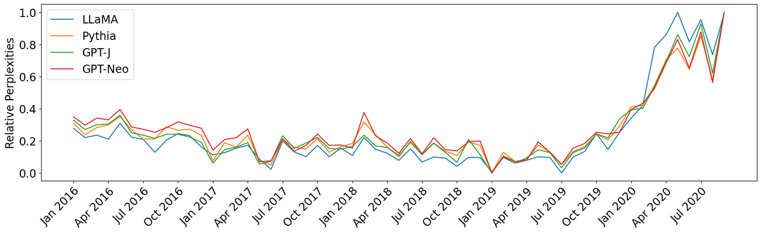
NYTimes

